Slide 1


Proposal Submission &
Review Procedures
A Handbook for RGCB Investigators
Version 02 Date: June 15,2020

Slide 2
Purpose of the Document
A quick reference handbook to support RGCB Investigators towards effective project submissions for consideration by the RGCB IHEC committee.

Slide 3
Overview of the Contents
Scope
Composition of EC
Regulatory Body & References
IHEC Office Details
Ethics Committee Timelines
Types of Applications
Application Packages
Submission Procedures
Handling of Applications
Decision Process
Decision Communication

Slide 4
Scope of the RGCB IHEC
The purpose of EC review is to protect the safety, rights, and well-being of research participants and to promote ethically sound research.
RGCB IHEC is accredited by SIDCER (Strategic Initiative for Developing Capacity in Ethical Review) in collaboration with FERCAP (Forum for Ethical Review Committees in Asia and the Western Pacific Region).

Slide 5
Scope of the Document
The main purpose of this document is to provide guidelines for the;
Submission of the research proposals for initial review.
Resubmission of research proposal with corrections and amendments.
Submission of approved protocols for continuing review.
Submission of the study completion reports.
Submission for any special requests on previously approved proposals.

Slide 6
Composition of EC
Sl No | Name | Role in IHEC
1 | Justice K Padmanabhan Nair | Chairperson
2 | Mr. Raman Srivastava | Vice Chairperson /Lay person
3 | Dr. V. Ramankutty | Clinician
4 | Dr. H. V. Easwer | Clinician
5 | Dr. K. Ramadas | Clinician
6 | Dr. S. Remadevi | Social Scientist
7 | Dr. Nandini K Kumar | Ethicist
8 | Advocate Benoy T George | Legal expert
9 | Dr. Devasena Anantharaman | Member Secretary
10 | Dr. Debasree Dutta | Alternate Member Secretary/ Basic Scientist
11 | Dr. Priya Srinivas | Basic Scientist
12 | Dr. E. Sreekumar | Basic Scientist
13 | Dr. Asha S Nair | Basic Scientist

Slide 7
Regulatory Body
Drugs Controller General of India : https://cdsco.gov.in/opencms/opencms/en/Home/
Department of Health Research: https://dhr.gov.in/
References
ICMR 2017 Guidelines
https://www.icmr.nic.in/sites/default/files/guidelines/ICMR_Ethical_Guidelines_2017.pdf
FERCI SOP: http://ferci.org/

Slide 8
Contact Details
Institutional Human Ethics Committee Office
Fourth floor, Next to HPV Lab
RGCB Main Campus
Extension No: 448
Timing : 9am to 5.30pm
Member Secretary: Dr. Devasena Anantharaman
Secretariat: Divya Jayalekshmy
Email: ihec@rgcb.res.in

Slide 9
Ethics Committee Timelines
Sl No | Description | Timeline | Notes
1 | Submission of proposals | Year Around | The hard copies of the proposals will be accepted at the IHEC office in the fourth floor
2 | EC meeting schedule Full committee review Expedited committee review Exemption review | Every three months Every month Continuous | IHEC full committee review meetings will be held every three months
3 | Decision making communication | within 14 days after the EC meeting | PI has to submit a response to the EC queries within 14 days of receipt of the letter of comments.

Slide 10
Type of Applications
Sl No | Type of applications | Category to apply
1 | New proposals/initial review | All the research proposals involving human subjects has to undergo IHEC approval
2 | Resubmission of the proposals with major/minor amendments | All the research proposals which requires significant/minor modifications after the initial full committee review
3 | Continuing review/progress report | All the ongoing research proposals has to be reviewed once a year to evaluate the progress of the study
4 | Completion of the study | After the completion of the study, final report has to be submitted by the PI’s for reviewing.
5 | Special request | Any minor changes (title change or collaborator change) in the previously approved study has to be resubmitted with supporting documents.

Slide 11
Application packages
Mandatory documents
Covering letter to the Member Secretary/Chairperson
Project submission application form duly filled
Protocol summary
Duty delegation log of the study team
Informed consent document (ICD) in English, Malayalam and any other local language as applicable
Sanction letter from the head of the institution
Brief curriculum vitae of all the study members

Slide 12
Continued…
Supporting documents (if applicable)
Ethical committee clearance letter from collaborating centers
Informed consent waiver form
MOU from the collaborating centers
Institutional stem cell research committee approval

Slide 13
Application Packages
Type of Applications | Mandatory documents | Supporting documents
Resubmission proposals (with major or minor amendments) | Covering letter to the Member Secretary/ Chairperson | List of point wise reply to the RGCB IHEC letter of comments (proposal amendment request form). Supporting documents (Revised version of protocol, ICD, case record forms etc.,) wherever applicable with changes made to the documents highlighted
Continuing review |  | Continuing review application form duly filled Supporting documents wherever applicable
Completion report |  | In case of multi centric studies, site specific final report to be submitted
Special requests |  | Proposal amendment form with supporting documents

Slide 14
Submission Procedure
To be submitted year around or 30 days prior to the EC meeting
Submit 5 hard copies (one original and 4 copies) of the research proposal &
1 soft copy to ihec@rgcb.res.in
Verification of the submission package at the IHEC office
Stamping & assigning IHEC protocol ID
Acknowledgment of the submission

Slide 15
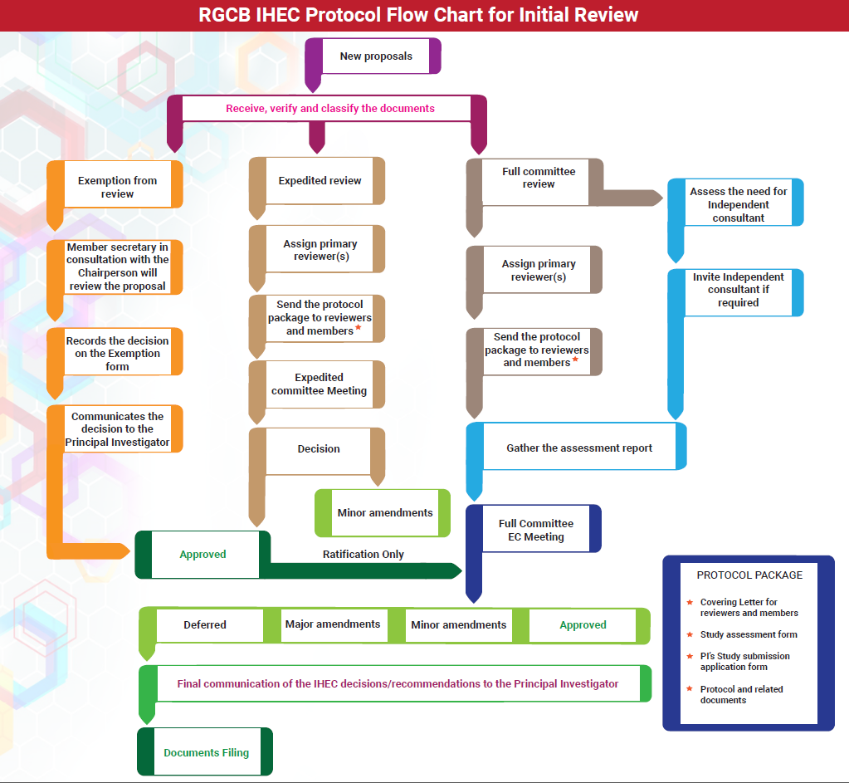
Handling of Applications

Slide 16
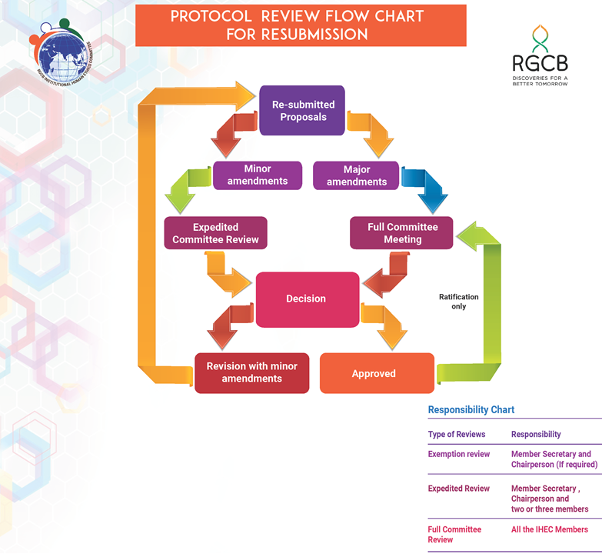
Handling of Applications

Slide 17
Handling of Applications
Progress applications
Completion report
Special requests
In case of major protocol change, risk assessment
Expedited review
Full committee
EC Decision
Additional information/recommendation
Accepted

Slide 18
Decision Process
Decision Types | Committee to reconsider proposal | Timeline
Approved | None | Not applicable
Major Amendments* | Full committee review | Up to 180 days of EC decision
Minor Amendments | Expedited committee review | Up to 14days of EC decision
Deferred* | Full committee review | Up to 180 days of EC decision
* In case of continuous non-response to reminders by the EC office, proposal will be dropped and the file will be closed.

Slide 19
Decision communication
Decision will be notified to the Investigators by email within 14 working days after the meeting.

Slide 20
Thank you

